Slide 1
🌱 How you can grow team culture with PETALS
Si Jobling

Slide 2
WHOAMI_
Engineering Manager, former Delivery Lead & Agile Delivery Manager @ Rightmove, ASOS and Alibaba
Leading teams of software engineers since 2017 using engineering background to relate
Passionate about collaboration, communication and culture across all disciplines

Slide 3
What are Team Health Checks? 💖
“Team Health Checks can help provide insight into a wide range of topics that can have a significant impact on employee happiness and satisfaction.
“It’s an opportunity to get visibility into what’s going on in a team’s context or across a group of teams, at a particular moment in time.

Slide 4
When did you last take a health check?
Be honest.

Slide 5
💗 Encourages continuous improvement culture

Slide 6
👥 Understand how teams are FEELING on common factors
Notes:
(Consider different personality types, e.g. introverts/extroverts, neurodiversity, Myers Briggs)

Slide 7
🏢 Leaders get an early indication of celebrations, concerns or problem areas

Slide 8
What already exists?

Slide 9
Spotify Squad Health Check
Spotify Engineering Blog https://engineering.atspotify.com/2014/09/squad-health-check-model/ (September 2014)
🚦 Simple traffic light system across comprehensive list of 11 factors.
🕐 Requires at least 1 hour to go through all topics.
🗓️ Generally referenced every 3-6 months across multiple teams.

Slide 10
DORA
Google Cloud DevOps Research & Assessment https://dora.dev/ (circa 2020)
4️⃣ Four key metrics to measure devops performance
🧑‍💻 Tech-delivery specific topics focused on deployment frequency, lead time for changes, change failure rate and time to restore service.
📊 Regular checkpoints closer aligned to real time metrics.

Slide 11
How can teams identify common factors to improve themselves?

Slide 12
How can we encourage teams to be self-aware?

Slide 13
How can we get a regular pulse of team health?

Slide 14
Time for PETALS!

Slide 15
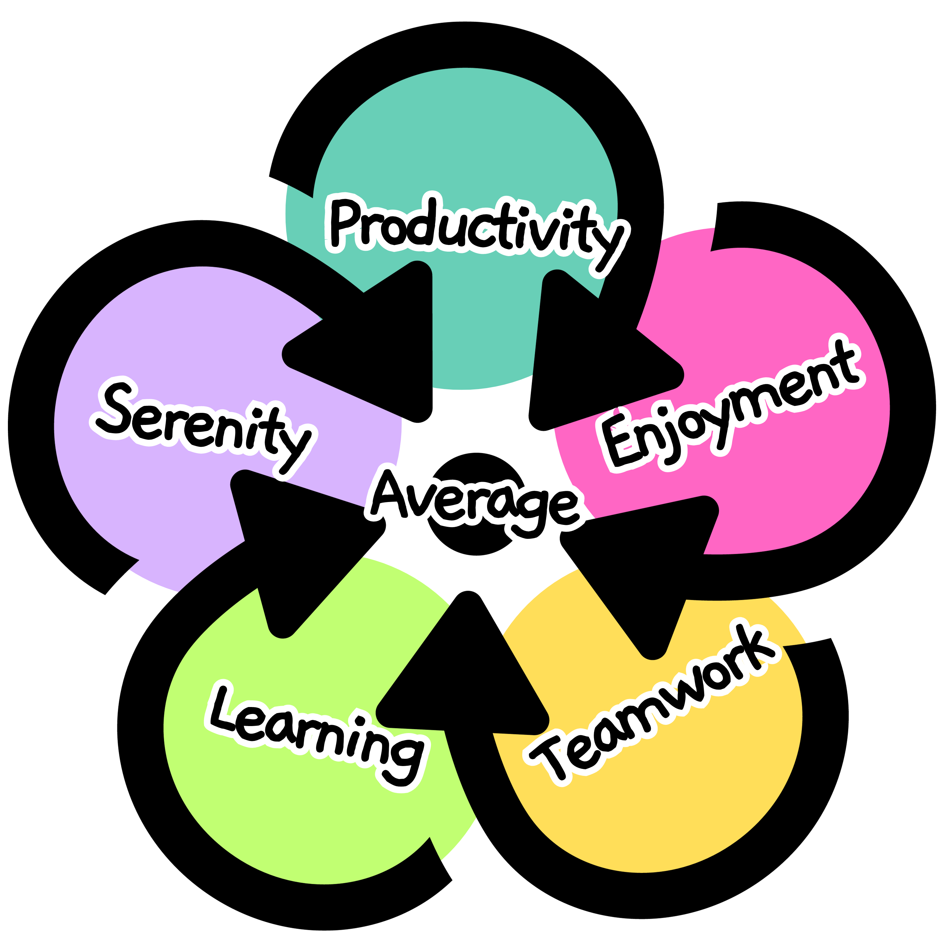
Acronym for common factors of healthy teams
Productivity
Enjoyment
Teamwork
Learning
Serenity
(Average)

Slide 16
Visualise the data
Calculate specific and overall averages from all team contributions.
Colour code live results with traditional red-amber-green spectrum in flower arrangement.
Plot all results over time on a line chart to see trends.

Slide 18
Data needs discussing
Scores are subjective and arbitrary. You can’t compare teams.
Look at overall averages, trends over time and outliers.
Teams encouraged to talk through individual scores with personal reasons.
Note down actions, improvement areas and breakout discussions for follow-up.

Slide 19
Who's using PETALS?

Slide 20
The Reluctant Team
One team were unsure why they should use PETALS.
An engineer saw the opportunity to present the benefits and approach.
Team now take fortnightly health checks every retrospective then discuss actions every four based on qualitative trending data.

Slide 21
The Experimental Team
Another team regularly try new things to see what fits.
Introduced PETALS on a retrospective to understand the pros and cons.
After several iterations, organised dedicated SEPERATE session every other Thursday to take health check, discuss observations and take actions to the NEXT retrospective.

Slide 22
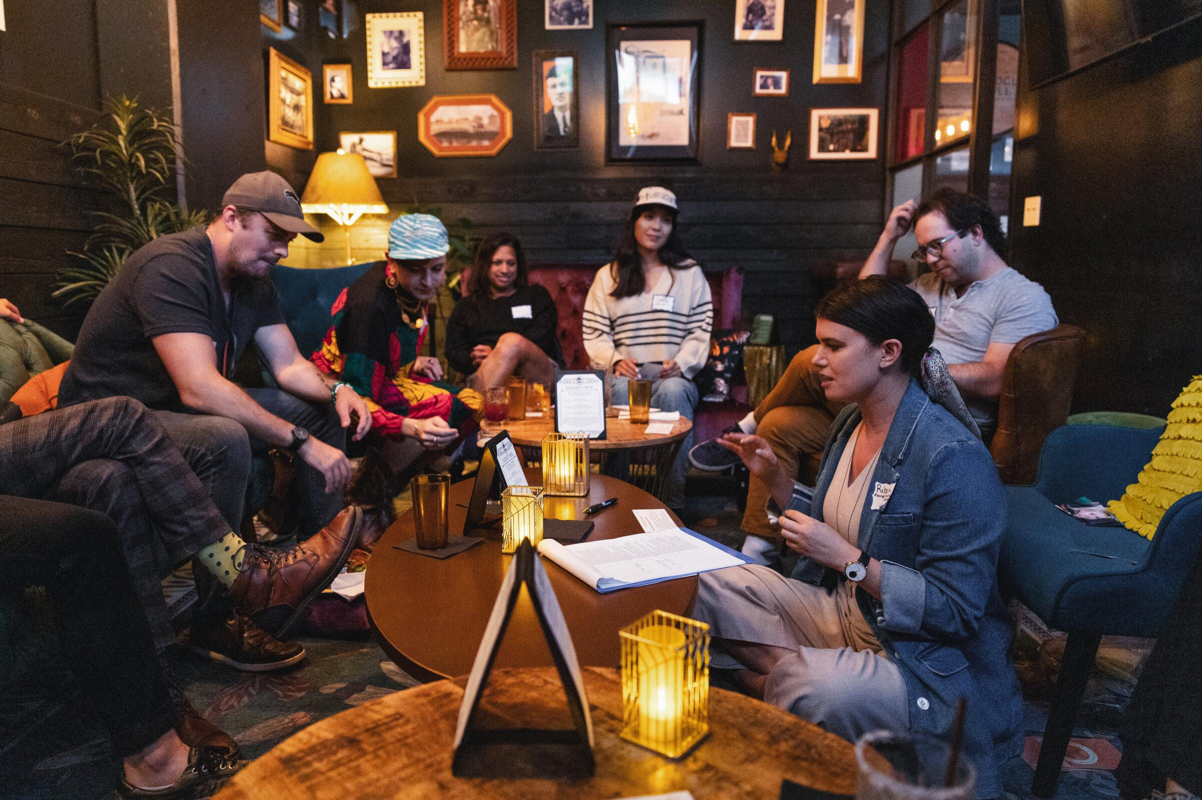
The Traditional Team
Another team's engineer wanted to try introducing but concerned it wouldn't land due to complacency.
Planned to try taking the framework offline to a pub environment for different scenery and relaxed environment.
Data captured after standup, compiled on print-outs & taken to local pub for afternoon retro.
Team agreed on plenty improvement areas and to continue regular checkpoints.

Slide 23
BONUS: The One To One
Whilst PETALS helps team structure discussions, some engineers find it useful to structure regular catch-ups with managers.
Avoids the "nothing to discuss" moments or helps work through low morale situations.
Either use recent team scores or go through them live for more accurate reflections.

Slide 24
It is growing…
53 software teams now using regularly across ASOS Tech
30 members on the LinkedIn group
70 newsletter subscribers including many recognizable brands

Slide 25
An app is coming
Custom built in Django as a side hustle.
Based on internal versions, learning from what works and helps teams.
Built for one or more teams in mind.
Get early access at https://petals.team/newsletter

Slide 26
Try it out!
📨 Register for early app access https://petals.team/newsletter
🧰 Use the Toolkits https://petals.team/toolkits (Google Workspace ready, Microsoft Forms+Excel and Miro needs more trial users)
#️⃣ Join the conversation in Slack https://petals.team/slack

Slide 27
Questions?
Ask now or reach out @sijobling on the socials

